Slide 1


Slide 2
INTRODUCTION
NAME: MUHAMMAD NAWAZ KHAN
ROLL NO: 19SW78
SEC: III
TEACHER: MOHSIN ALI MEMON

Slide 3
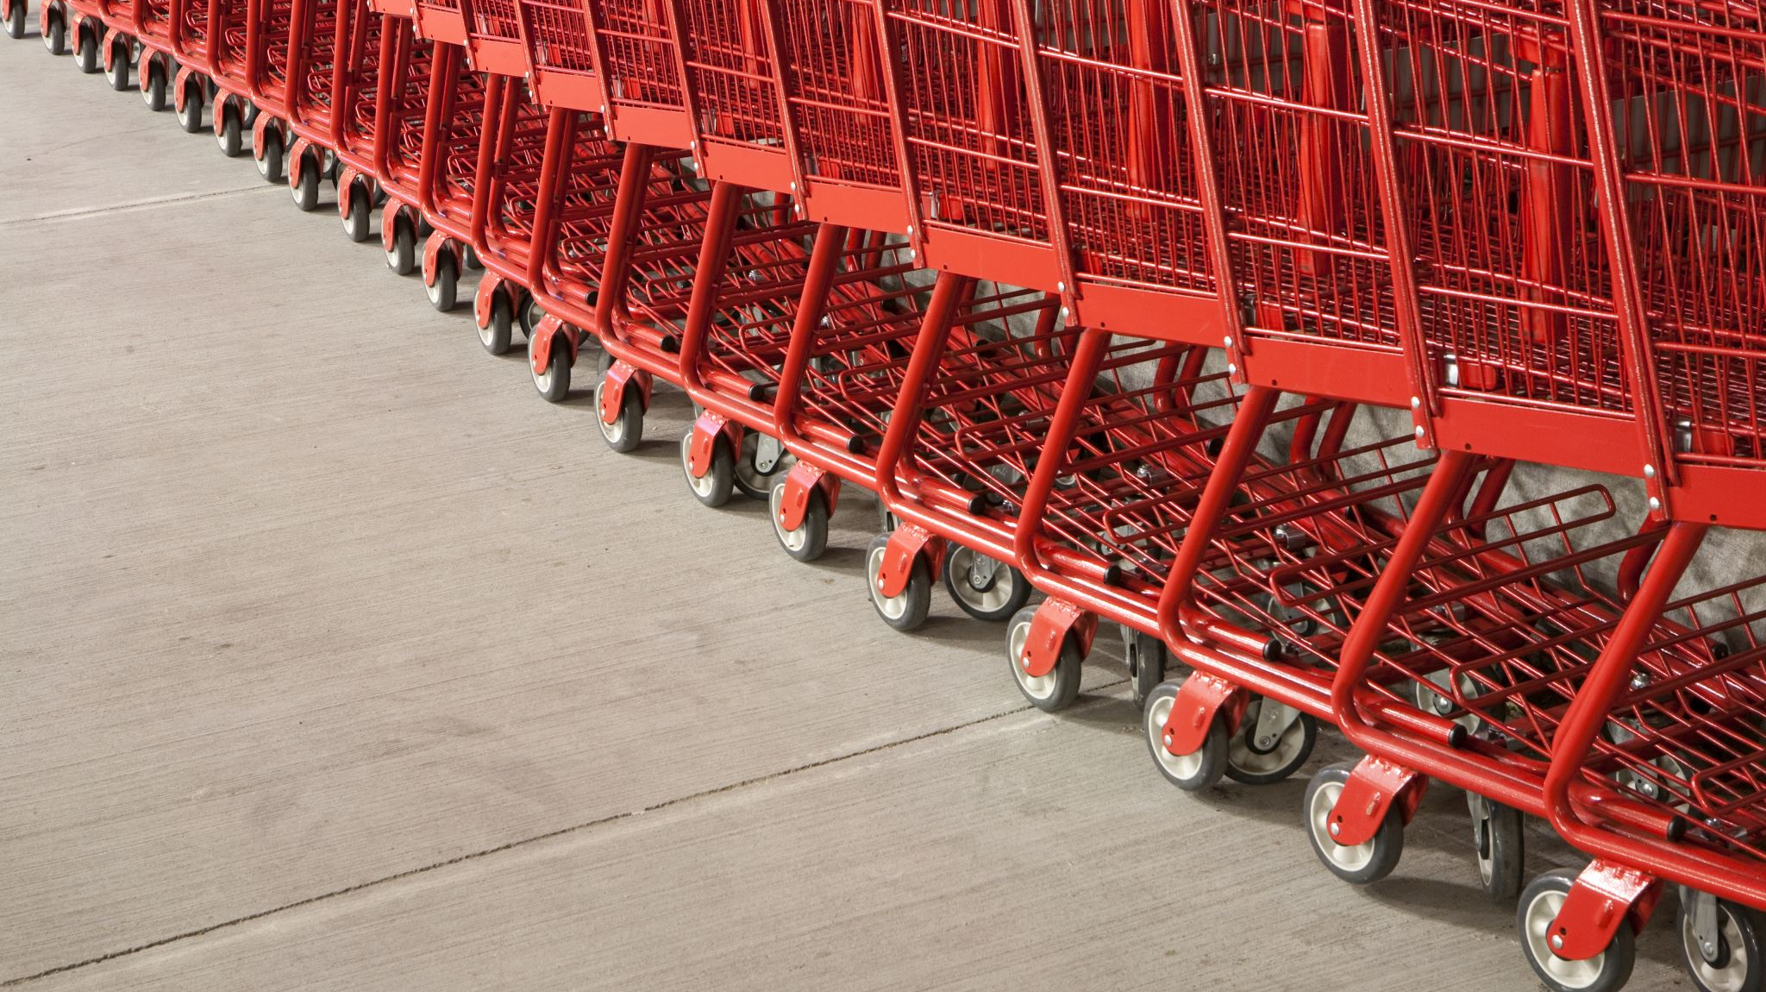
SHOPPING CENTER

Slide 4
Add product in the store by entering ID ,Name, price ,Quantity
Add
LINKED LIST
Display
Modify
Administrator
remove
Queue List
Shopping club
Customer
DE queue
Take trollie
Back to main
STACK
Exit
Buy something
ARRAY
Enter name queue
QUEUE
Program terminate

Slide 5

THANK YOU

Slide 6
LINK
https://youtu.be/87q-WuO7vJE

